Slide 1


Approximate Queries on Very Large Data
Sameer Agarwal
Joint work with Ariel Kleiner, Henry Milner, Barzan Mozafari, Ameet Talwalkar, Michael Jordan, Samuel Madden, Ion Stoica
UC Berkeley

Slide 2
Our Goal
Support interactive SQL-like aggregate queries over massive sets of data

Slide 3
Our Goal
Support interactive SQL-like aggregate queries over massive sets of data
blinkdb> SELECT AVG(jobtime)
FROM very_big_log
AVG, COUNT, SUM, STDEV, PERCENTILE etc.

Slide 4
Our Goal
Support interactive SQL-like aggregate queries over massive sets of data
blinkdb> SELECT AVG(jobtime)
FROM very_big_log
WHERE src = ‘hadoop’
FILTERS, GROUP BY clauses

Slide 5
Our Goal
Support interactive SQL-like aggregate queries over massive sets of data
blinkdb> SELECT AVG(jobtime)
FROM very_big_log
WHERE src = ‘hadoop’
LEFT OUTER JOIN logs2
ON very_big_log.id = logs.id
JOINS, Nested Queries etc.

Slide 6
Our Goal
Support interactive SQL-like aggregate queries over massive sets of data
blinkdb> SELECT my_function(jobtime)
FROM very_big_log
WHERE src = ‘hadoop’
LEFT OUTER JOIN logs2
ON very_big_log.id = logs.id
ML Primitives,
User Defined Functions

Slide 7


100 TB on 1000 machines
½ - 1 Hour
1 - 5 Minutes
1 second
?
Hard Disks
Memory
Query Execution on Samples

Slide 8
Query Execution on Samples
ID | City | Buff Ratio
1 | NYC | 0.78
2 | NYC | 0.13
3 | Berkeley | 0.25
4 | NYC | 0.19
5 | NYC | 0.11
6 | Berkeley | 0.09
7 | NYC | 0.18
8 | NYC | 0.15
9 | Berkeley | 0.13
10 | Berkeley | 0.49
11 | NYC | 0.19
12 | Berkeley | 0.10
What is the average buffering ratio in the table?
0.2325

Slide 9
Query Execution on Samples
ID | City | Buff Ratio
1 | NYC | 0.78
2 | NYC | 0.13
3 | Berkeley | 0.25
4 | NYC | 0.19
5 | NYC | 0.11
6 | Berkeley | 0.09
7 | NYC | 0.18
8 | NYC | 0.15
9 | Berkeley | 0.13
10 | Berkeley | 0.49
11 | NYC | 0.19
12 | Berkeley | 0.10
What is the average buffering ratio in the table?
ID | City | Buff Ratio | Sampling Rate
2 | NYC | 0.13 | 1/4
6 | Berkeley | 0.25 | 1/4
8 | NYC | 0.19 | 1/4
Uniform
Sample
0.2325
0.19

Slide 10
Query Execution on Samples
ID | City | Buff Ratio
1 | NYC | 0.78
2 | NYC | 0.13
3 | Berkeley | 0.25
4 | NYC | 0.19
5 | NYC | 0.11
6 | Berkeley | 0.09
7 | NYC | 0.18
8 | NYC | 0.15
9 | Berkeley | 0.13
10 | Berkeley | 0.49
11 | NYC | 0.19
12 | Berkeley | 0.10
What is the average buffering ratio in the table?
ID | City | Buff Ratio | Sampling Rate
2 | NYC | 0.13 | 1/4
6 | Berkeley | 0.25 | 1/4
8 | NYC | 0.19 | 1/4
Uniform
Sample
0.2325
0.19 +/- 0.05

Slide 11
Query Execution on Samples
ID | City | Buff Ratio
1 | NYC | 0.78
2 | NYC | 0.13
3 | Berkeley | 0.25
4 | NYC | 0.19
5 | NYC | 0.11
6 | Berkeley | 0.09
7 | NYC | 0.18
8 | NYC | 0.15
9 | Berkeley | 0.13
10 | Berkeley | 0.49
11 | NYC | 0.19
12 | Berkeley | 0.10
What is the average buffering ratio in the table?
ID | City | Buff Ratio | Sampling Rate
2 | NYC | 0.13 | 1/2
3 | Berkeley | 0.25 | 1/2
5 | NYC | 0.19 | 1/2
6 | Berkeley | 0.09 | 1/2
8 | NYC | 0.18 | 1/2
12 | Berkeley | 0.49 | 1/2
Uniform
Sample
0.2325
0.19 +/- 0.05
$0.22 +/- 0.02

Slide 12
Speed/Accuracy Trade-off
Interactive
Queries
Error
Time to Execute on
Entire Dataset
5 sec
30 mins
Execution Time

Slide 13
Speed/Accuracy Trade-off
Interactive
Queries
Error
Time to Execute on
Entire Dataset
Pre-Existing
Noise
5 sec
30 mins
Execution Time

Slide 14
Sampling Vs. No Sampling
1020
10x as response time
is dominated by I/O
Query Response Time (Seconds)
103
18
13
10
8
1
10⁻¹
10⁻²
10⁻³
10⁻⁴
10⁻⁵
Fraction of full data

Slide 15
Sampling Vs. No Sampling
1020
Error Bars
Query Response Time (Seconds)
(0.02%)
103
(0.07%)
(1.1%)
(3.4%)
(11%)
18
13
10
8
1
10⁻¹
10⁻²
10⁻³
10⁻⁴
10⁻⁵
Fraction of full data

Slide 16

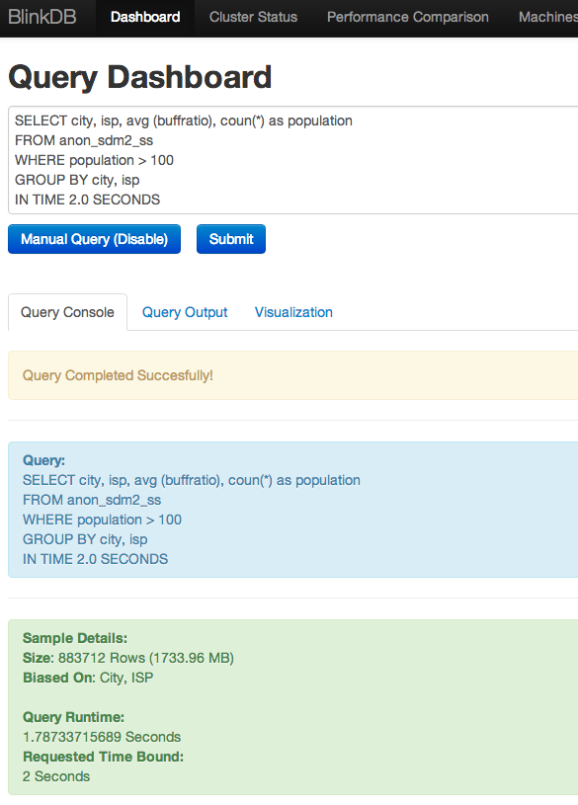
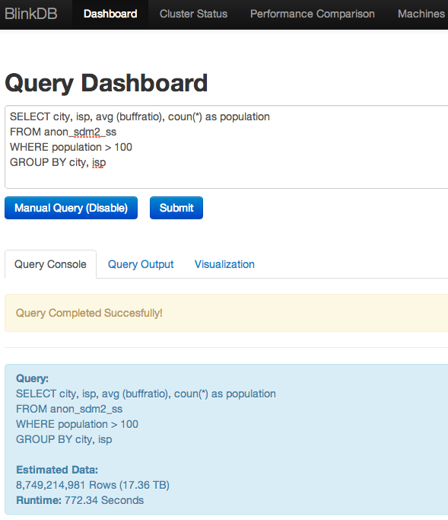
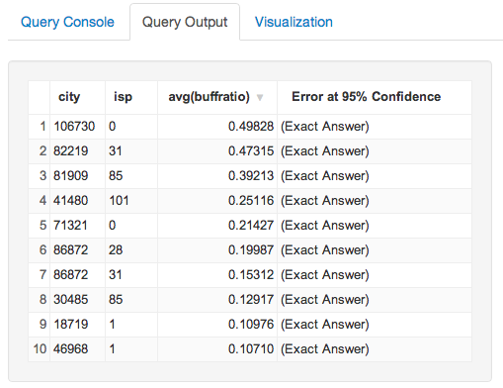
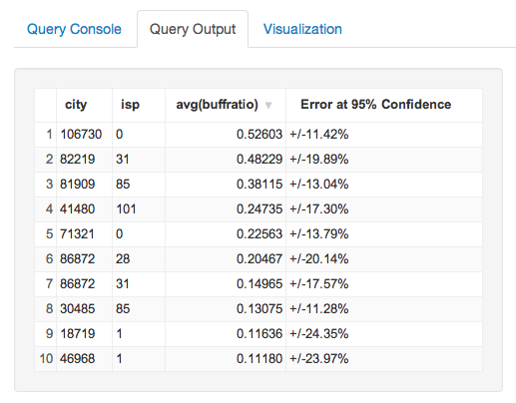
Video Quality Diagnosis
Top 10 worse performers identical!
440x faster!
Latency: 772.34 sec
(17TB input)
Latency: 1.78 sec
(1.7GB input)

Slide 17
What is BlinkDB?
A data analysis (warehouse) system that …
creates and maintains a variety of random and stratified samples from underlying data
returns fast, approximate answers with error bars by executing queries on samples of data
is compatible with Apache Hive, AMP Lab’s Shark and Facebook’s Presto (storage, serdes, UDFs, types, metadata)

Slide 18
What is BlinkDB?
A data analysis (warehouse) system that …
creates and maintains a variety of random and stratified samples from underlying data
returns fast, approximate answers with error bars by executing queries on samples of data
is compatible with Apache Hive, AMP Lab’s Shark and Facebook’s Presto (storage, serdes, UDFs, types, metadata)

Slide 19
Samples
ID | City | Buff Ratio
1 | NYC | 0.78
2 | NYC | 0.13
3 | Berkeley | 0.25
4 | NYC | 0.19
5 | NYC | 0.11
6 | Berkeley | 0.09
7 | NYC | 0.18
8 | NYC | 0.15
9 | Berkeley | 0.13
10 | Berkeley | 0.49
11 | NYC | 0.19
12 | Berkeley | 0.10
ID | City | Buff Ratio | Sampling Rate
2 | NYC | 0.13 | 1/3
8 | NYC | 0.25 | 1/3
6 | Berkeley | 0.09 | 1/3
11 | NYC | 0.19 | 1/3
Uniform
Sample
ID | City | Buff Ratio | Sampling Rate
2 | NYC | 0.13 | 2/7
8 | NYC | 0.25 | 2/7
6 | Berkeley | 0.09 | 2/5
12 | Berkeley | 0.49 | 2/5
Stratified
Sample

Slide 20
Uniform Samples
blinkdb> create table A_sample as select * from A samplewith 0.01;
Create a 1% random sample A_sample from A
1.
SELECT A.*
FROM A
WHERE rand() < 0.01
ORDER BY rand()
2.
Keep track of per block
scaling information

Slide 21
Stratified Samples
blinkdb> create table A_sample as select * from A samplewith 0.01 stratify on (col_A);
Create a 1% stratified sample A_sample from A biased on col_A
1.
SELECT A.*
from A JOIN
(SELECT K, logic(count(*)) AS ratio
FROM A
GROUP BY K)
USING K
WHERE rand() < ratio;
2.
Keep track of per block scaling information

Slide 22
What is BlinkDB?
A data analysis (warehouse) system that …
creates and maintains a variety of random and stratified samples from underlying data
returns fast, approximate answers with error bars by executing queries on samples of data
is compatible with Apache Hive, AMP Lab’s Shark and Facebook’s Presto (storage, serdes, UDFs, types, metadata)

Slide 23
Approximate Answers
blinkdb> select count(1) from A_sample where event = “foo”;
12810132 +/- 3423 (99% Confidence)
Also supports: sum(),avg(),stdev(), var()

Slide 24
What is BlinkDB?
A data analysis (warehouse) system that …
creates and maintains a variety of random and stratified samples from underlying data
returns fast, approximate answers with error bars by executing queries on samples of data
is compatible with Apache Hive, AMP Lab’s Shark and Facebook’s Presto (storage, serdes, UDFs, types, metadata)

Slide 25
BlinkDB Architecture
Command-line Shell
Thrift/JDBC
Meta
store
Driver
SQL Parser
Query Optimizer
Physical Plan
SerDes, UDFs
Execution
Hadoop/Spark/Presto
Hadoop Storage (e.g., HDFS, Hbase, Presto)

Slide 26
BlinkDB alpha-0.1.0
Released and available at http://blinkdb.org
Allows you to create random and stratified samples on native tables and materialized views
Adds approximate aggregate functions with statistical closed forms to HiveQL : approx_avg(), approx_sum(), approx_count() etc.

Slide 27
Feature Roadmap
Integrating BlinkDB with Facebook’s Presto and Shark as an experimental feature
Automatic Sample Management
More Hive Aggregates, UDAF Support
Runtime Correctness Tests

Slide 28
Automatic Sample Management
Goal: The API should abstract the details of creating, deleting and managing samples from the user
SELECT avg(sessionTime)
FROM Table
WHERE city=‘San Francisco’
WITHIN 1 SECONDS
234.23 ± 15.32

Slide 29
Automatic Sample Management
Goal: The API should abstract the details of creating, deleting and managing samples from the user
SELECT avg(sessionTime)
FROM Table
WHERE city=‘San Francisco’
WITHIN 2 SECONDS
234.23 ± 15.32
239.46 ± 4.96

Slide 30
Automatic Sample Management
Goal: The API should abstract the details of creating, deleting and managing samples from the user
SELECT avg(sessionTime)
FROM Table
WHERE city=‘San Francisco’
ERROR 0.1 CONFIDENCE 95.0%

Slide 31
Automatic Sample Management
Offline-sampling: Creates an optimal set of samples on native tables and materialized views based on query history and workload characteristics
TABLE
Sampling Module
Original
Data

Slide 32
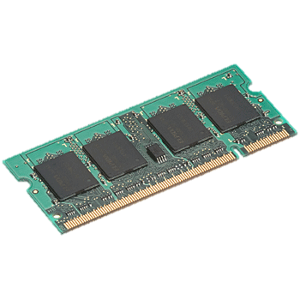
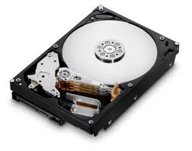
Automatic Sample Management
Sample Placement: Samples striped over 100s or 1,000s of machines both on disks and in-memory.
TABLE
Sampling Module
Original
Data
On-Disk
Samples
In-Memory
Samples

Slide 33
Automatic Sample Management
SELECT
foo (*)
FROM TABLE
WITHIN 2
Query Plan
Sample Selection
HiveQL/SQL
Query
TABLE
Sampling Module
Original
Data
On-Disk
Samples
In-Memory
Samples

Slide 34
Automatic Sample Management
SELECT
foo (*)
FROM TABLE
WITHIN 2
Query Plan
Sample Selection
HiveQL/SQL
Query
Online sample selection to pick best sample(s) based on query latency and accuracy requirements
TABLE
Sampling Module
Original
Data
On-Disk
Samples
In-Memory
Samples

Slide 35
Automatic Sample Management
SELECT
foo (*)
FROM TABLE
WITHIN 2
New Query Plan
Error Bars & Confidence Intervals
Sample Selection
Hive/Shark/Presto
HiveQL/SQL
Query
Result
182.23 ± 5.56
(95% confidence)
TABLE
Sampling Module
Parallel query execution on multiple samples striped across multiple machines.
Original
Data
On-Disk
Samples
In-Memory
Samples

Slide 36
More Aggregates/ UDAFs Support
Using Bootstrap to estimate error
Sample
A

Slide 37
More Aggregates/ UDAFs Support
Using Bootstrap to estimate error
Sample
Bootstrap Operator
…
…
A
A₁
A₂
A_{n}

Slide 38
More Aggregates/ UDAFs Support
Using Bootstrap to estimate error
Sample
Placement of the Bootstrap Operator in the query graph is critical to performance
…
…
A
A₁
A₂
A_{n}

Slide 39
Runtime Correctness Tests
Given a query, how do you know if it can be approximated at runtime?
Depends on the query, data distribution, and sample size
Need for runtime diagnosis tests
Check whether error improves as sample size increases
Need to be extremely fast!

Slide 40
Try Before You “Buy”
Try our BlinkDB workload evaluator!
assesses percentage of your Hive/Shark queries that can be approximated correctly
gives a per-query error/latency tradeoff
Currently in private beta. Public release in 2 weeks!

Slide 41
Getting Started
BlinkDB alpha-0.1.0 released and available at http://blinkdb.org
Takes just 5-10 minutes to run it locally or to spin an EC2 cluster
Hands-on Exercises at AMPLab’s Big Data Course

Slide 42
Summary
Approximate queries is an important means to achieve interactivity in processing large datasets
BlinkDB..
approximate answers with error bars by executing queries on small samples of data
supports existing Hive/Shark/Presto queries
For more information, please check out our EuroSys 2013 (http://bit.ly/blinkdb-1) and KDD 2014 (http://bit.ly/blinkdb-2) papers
Thanks!

